Slide 1

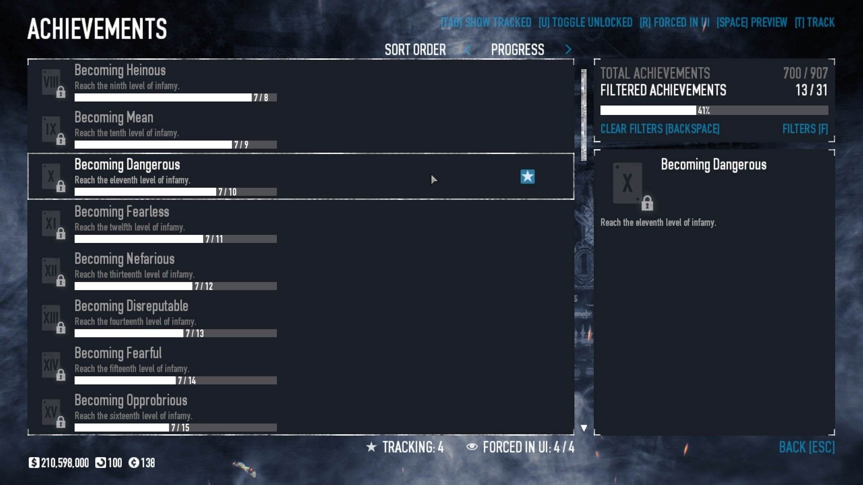


Game Mastery Tracker Luke Davis
All your achievements - in one place

